Slide 1
Week 14
Authors&works
Conrad, Shaw, Joyce, Woolf, T.S. Eliot, Beckett, Achebe, Larkin, Seamus Heaney, Rushdie, Ishiguro, Stoppard, Zadie Smith

Slide 2
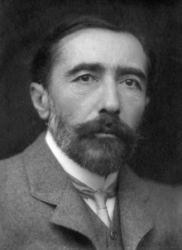
Joseph Conrad
Heart of Darkness
Lord Jim
Secret Agent

Slide 3
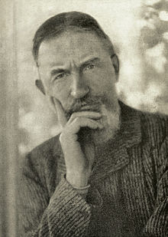
George Bernard Shaw
Widowers’ Houses
The Philanderer
Mrs Warren's Profession
Arms and the Man
Candida
You Never Can Tell
The Devil's Disciple
Caesar and Cleopatra
Captain Brassbound's Conversion

Slide 4
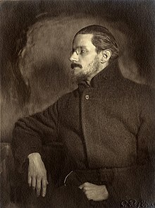
James Joyce
Dubliners (short-story collection, 1914)
A Portrait of the Artist as a Young Man (novel, 1916)
Ulysses (novel, 1922)
Finnegans Wake (1939)

Slide 5
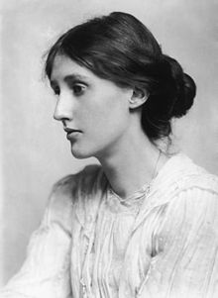
Virginia Woolf
Mrs Dalloway (1925)
To the Lighthouse (1927)
Orlando (1928)
A Room of One's Own (1929)
The Waves (1931)

Slide 6
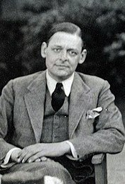
T. S. Eliot
«The Love Song of J. Alfred Prufrock»(1915)
The Waste Land (1922)
Four Quartets (1943)
Murder in the Cathedral (1935)
Nobel Prize in Literature (1948)

Slide 7
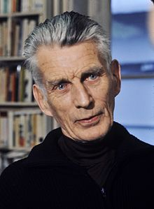
Samuel Beckett
Murphy
Watt
Molloy
Malone Dies
The Unnamable
Waiting for Godot
Endgame
Nobel Prize in Literature (1969)

Slide 8
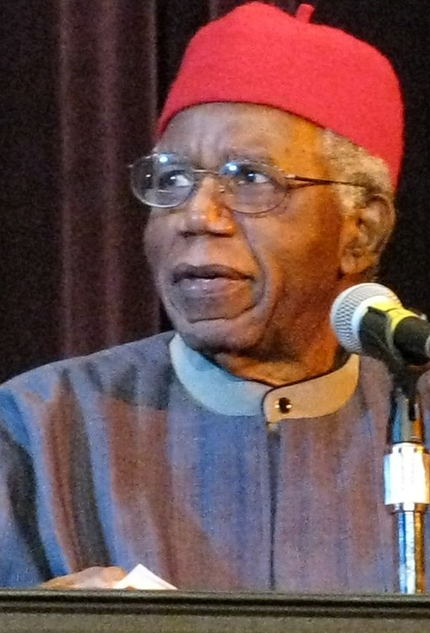
Chinua Achebe
"The African Trilogy":
— Things Fall Apart (1958)
— No Longer at Ease (1960)
— Arrow of God (1964)
A Man of the People (1966)
Anthills of the Savannah (1987)

Slide 9
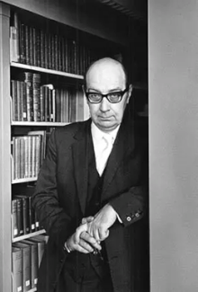
Philip Larkin
The Whitsun Weddings (1964),
High Windows (1974)
Poet

Slide 10
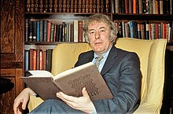
Seamus Heaney
 | Death of a Naturalist (1966) North (1975) Field Work (1979) The Spirit Level (1996) Beowulf: A New Verse Translation (translation, 1999) District and Circle (2006) Human Chain (2010)

Slide 11
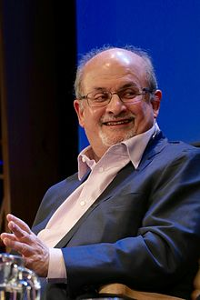
Salman Rushdie
Grimus (1975)
Midnight's Children (1981)
Shame (1983)
The Satanic Verses (1988)
The Moor's Last Sigh (1995)
Fury (2001)
Shalimar the Clown (2005)
The Enchantress of Florence (2008)

Slide 12
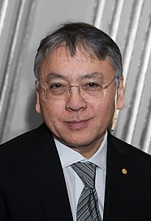
Kazuo Ishiguro
An Artist of the Floating World
The Remains of the Day
When We Were Orphans
Never Let Me Go
Klara and the Sun
2017 Nobel prize

Slide 13
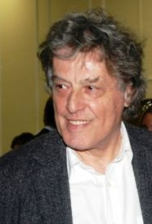
Tom Stoppard
1966: Rosencrantz and Guildenstern Are Dead

Slide 14
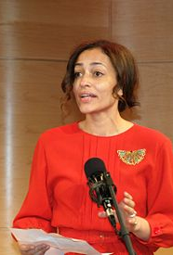
Zadie Smith
White Teeth (2000)
The Autograph Man (2002)
On Beauty (2005)
NW (2012)
Swing Time (2016)

